Slide 1

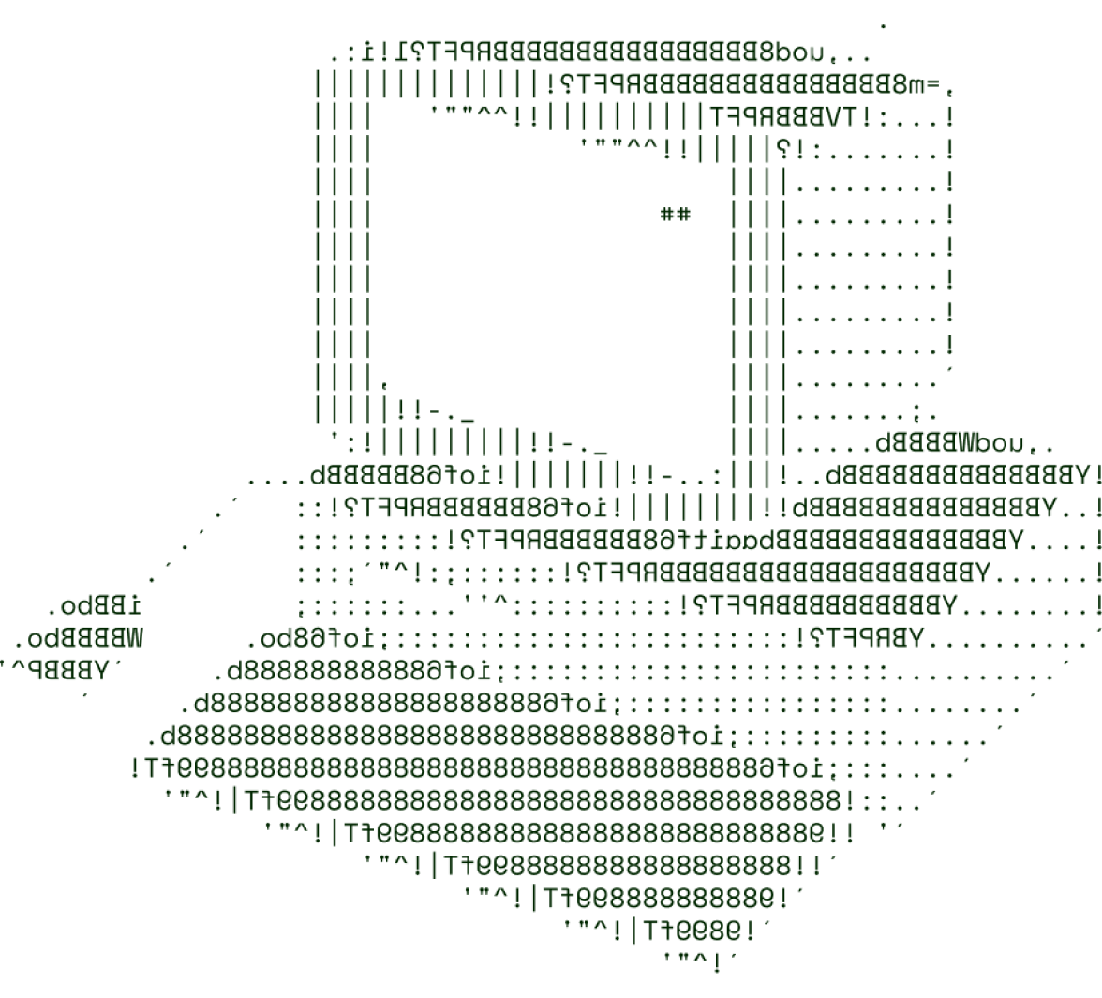
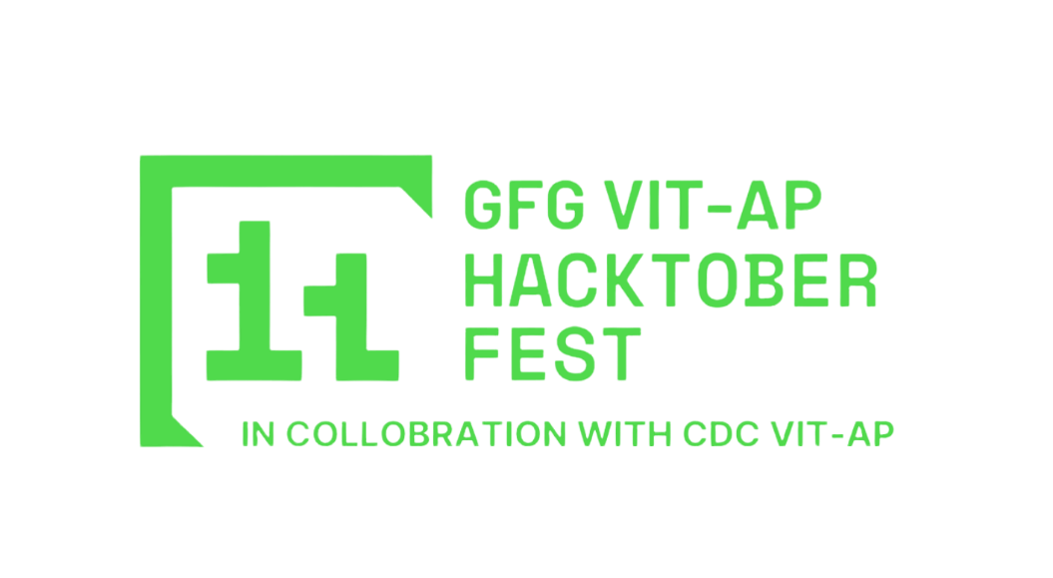
>Recognising Handwritten Devanagari Numerals using Machine Learning for Translating Ancient Texts.
(KRTRIMA MEDHASSU)

Slide 2

>SOLUTION OVERVIEW

Slide 3
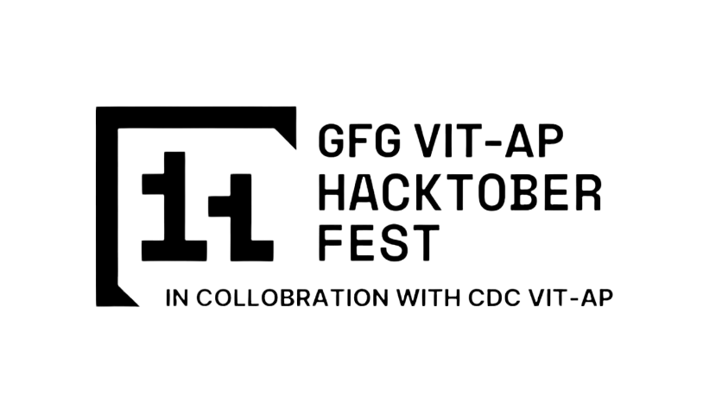
SOLUTION OVERVIEW
Briefly describe your solution or product.
This research presents a novel machine learning model tailored for recognizing handwritten Devanagari numerals, leveraging data pre-processing, feature extraction, and classification techniques to enhance accuracy and efficiency. The model is designed to address challenges unique to the Devanagari script, such as varying stroke patterns and intricacies in handwritten forms. The project explores a range of machine learning methods, including Support Vector Machines (SVM), Random Forests, K-Nearest Neighbours (KNN), and Convolutional Neural Networks (CNN). After extensive comparative analysis, the model highlights the most effective techniques, culminating in a model robust against variations in handwriting and suitable for real-world applications like OCR systems and digital documentation. This research provides significant advancements in the domain of handwritten text recognition, specifically for regional scripts.

Slide 4
SOLUTION OVERVIEW
How it addresses the problem.
The solution tackles the complex challenge of accurately recognizing handwritten Devanagari numerals. Recognizing handwritten text, especially in non-Latin scripts like Devanagari, requires handling diverse writing styles and intricate patterns. This model addresses these challenges through comprehensive preprocessing and feature extraction that prepare the data for machine learning analysis. Employing models like SVM, KNN, and CNN, the solution identifies the optimal approach for classifying Devanagari numerals. Data augmentation and cross-validation strengthen the model's resilience, ensuring consistent accuracy. By focusing on specific numeral recognition, this solution directly addresses OCR system limitations in supporting non-standard scripts, enhancing accessibility and usability in multilingual contexts.

Slide 5
SOLUTION OVERVIEW
Innovation and uniqueness of the solution
This solution's uniqueness lies in its focused approach to handwritten Devanagari numeral recognition, which is relatively underexplored in machine learning. By combining traditional and deep learning models, the research ensures a balanced analysis of performance, capturing strengths across different techniques. Employing cross-validation and statistical assessments offers robust insights, enhancing model reliability. Data augmentation techniques are innovatively applied to overcome dataset limitations, ensuring adaptability across varied handwriting styles. Additionally, the model serves as a foundation for future expansions into full-script Devanagari and other Indic scripts, potentially transforming multilingual OCR technology and advancing regional language digitization.

Slide 6
SOLUTION OVERVIEW
Highlight its key features and benefits.
Key features of this solution include a robust preprocessing pipeline, a comparative model analysis, and implementation of data augmentation and transfer learning for enhanced reliability. The model provides high accuracy rates, particularly with SVM, achieving 99.5% accuracy, and CNN’s efficacy in handling complex patterns. This solution benefits users by supporting document digitization and automated reading of handwritten Devanagari texts, aiding sectors like banking, healthcare, and government. Its applicability extends beyond Devanagari, paving the way for multilingual OCR capabilities. The model’s adaptability and accuracy contribute to efficient data processing, minimizing manual intervention in record management and information extraction

Slide 7
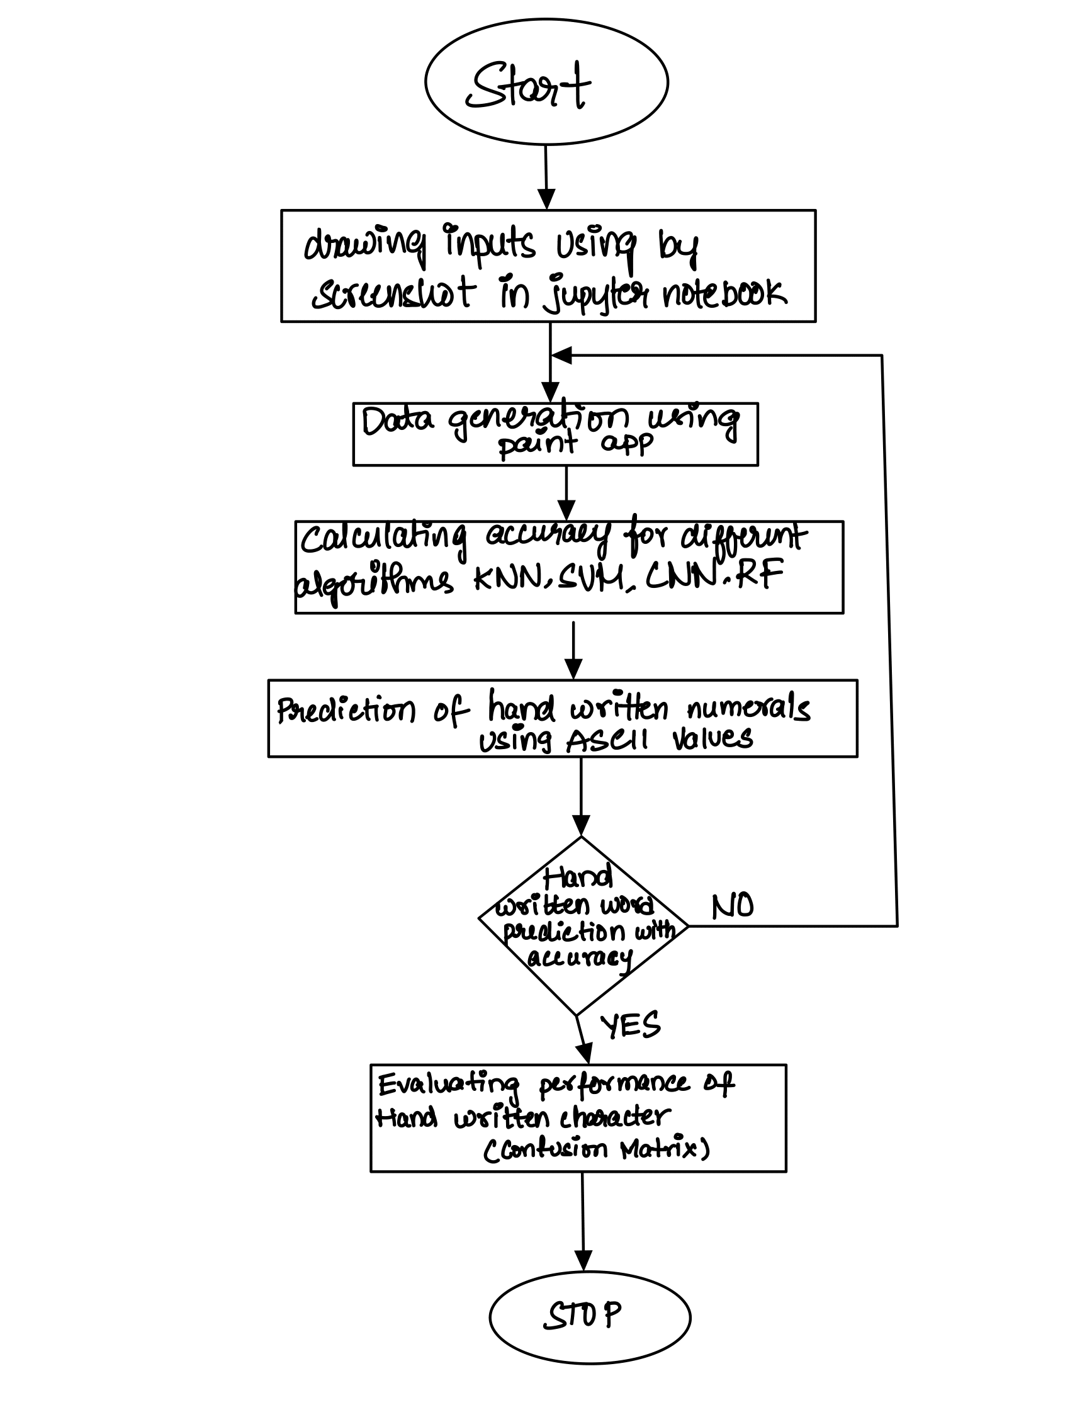
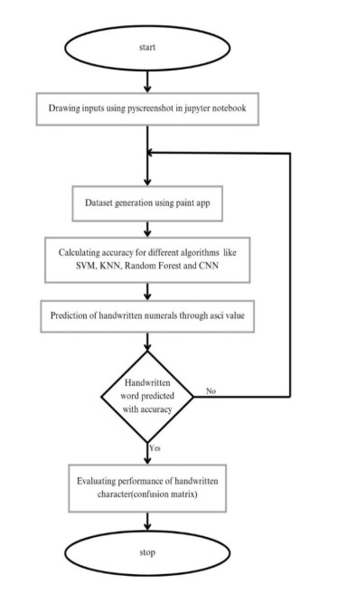
TECHNICAL ARCHITECTURE
Flowchart (Not Compulsory)

Slide 8
>TECHNICAL ARCHITECTURE

Slide 9
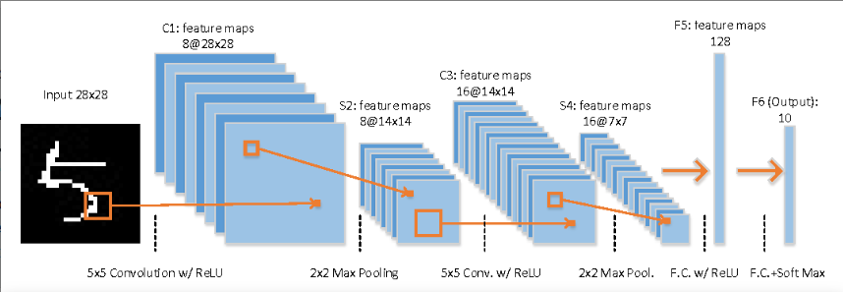
TECHNICAL ARCHITECTURE
Flowchart (Not Compulsory)

Slide 10
TECHNICAL ARCHITECTURE
Tech stack
Frameworks:ImageGra,pyscreeenshot,numpy,cv,opencv,sckit-learn,dtae-time,matplotlib
programming language: python
Teck stack-algo:svm , random forest , knn , CNN , DNN

Slide 11
>SCALABILITY AND FUTURE SCOPE

Slide 12
SCALABILITY AND FUTURE SCOPE
How your solution can handle increased load
Architecture considerations (e.g., cloud services, load balancing)
Technologies that support scalability (e.g., microservices, containerization)
Additional functionalities you plan to implement
To handle increased load, the solution leverages scalable cloud services, efficient architecture, and technologies that support high-volume processing. Cloud platforms like AWS or Google Cloud offer elastic scaling for model training and inference, while load balancers distribute traffic to prevent bottlenecks. Scalable storage solutions manage large datasets, and databases like DynamoDB or Firestore ensure efficient data retrieval.The system architecture integrates microservices for modular functionality, containerization with Docker and Kubernetes for easy scaling, and serverless functions (e.g., AWS Lambda) to manage costs with on-demand processing. CDN support enhances speed by caching frequently accessed data.Additional planned functionalities include extending recognition to the full Devanagari script and other languages, implementing real-time prediction, user feedback loops for continuous model refinement, and an analytics dashboard for insights. An automated retraining pipeline will ensure the model stays up-to-date, maintaining performance as data and user demands grow.

Slide 13
>FEASIBILITY

Slide 14
FEASIBILITY
Potential challenges and risks
Strategies for overcoming these challenges
Potential Challenges in Devanagari numerals classification include variability in handwriting styles,
limited dataset availability,
complexity in model generalization,
computational costs,
and potential bias in the dataset. Strategies to overcome these challenges include data augmentation, synthetic data generation, transfer learning, cross-validation, hyperparameter tuning, cloud-based computational resources, and bias mitigation through diverse data collection. By addressing these challenges, the Devanagari model can be more robust and accurate in real-world applications, ensuring a balanced model performance across different writing styles.

Slide 15
>TEAM DETAILS

Slide 16
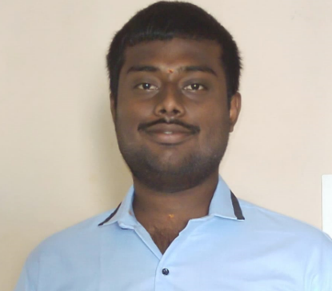


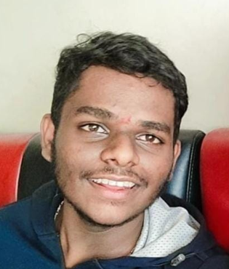



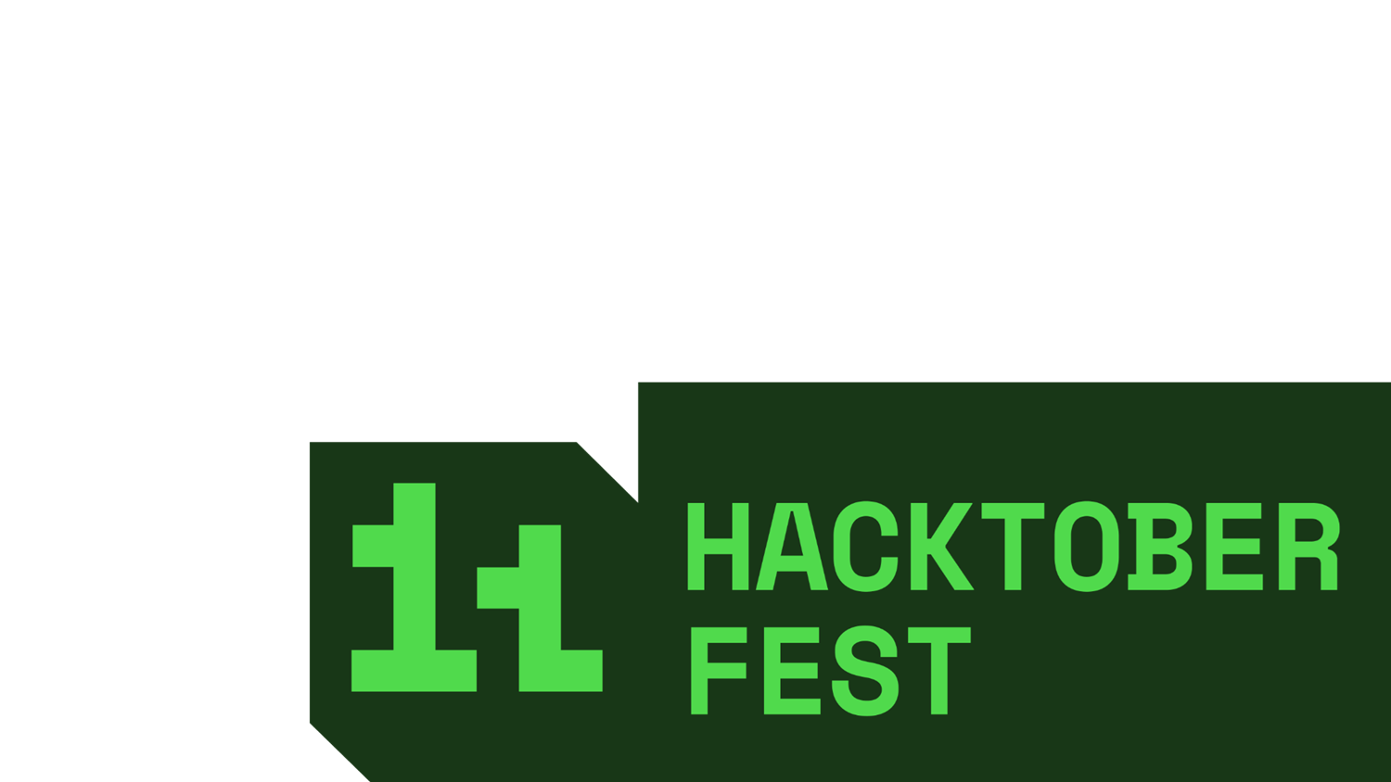
UTTEJ KUMAR
RITHVIK KORUTURU
LEAD
22BCE20179
MEMBER
22BCE8914
GOVINDA KRISHNA
KASHYAP GOVINDU
MEMBER
22BCE9159
MEMBER
22BEC7007

Slide 17

Thanks for Joining

